Slide 1
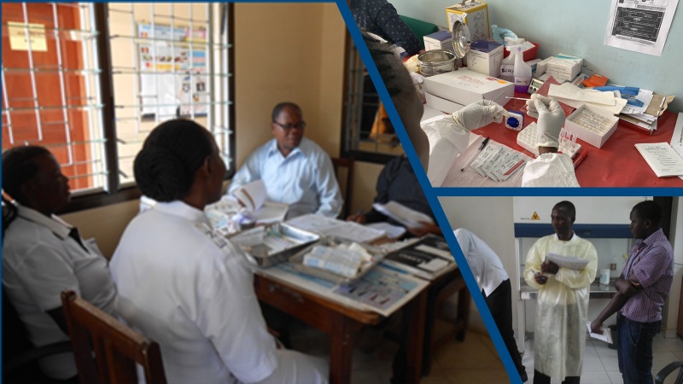
Stepwise Process for Improving the Quality HIV Rapid Testing Trainers Guide
A Skills Intensive Training Program To Audit HIV Testing Site Towards Certification

